Slide 1
Tools you can use
A look at UBCMS new features and components
DCT Solutions Group 10/9/14

Slide 2
Faces and Voices Component Key Tasks Component Header and Subtitle Component Demo Site Collapsible Grid

Slide 3
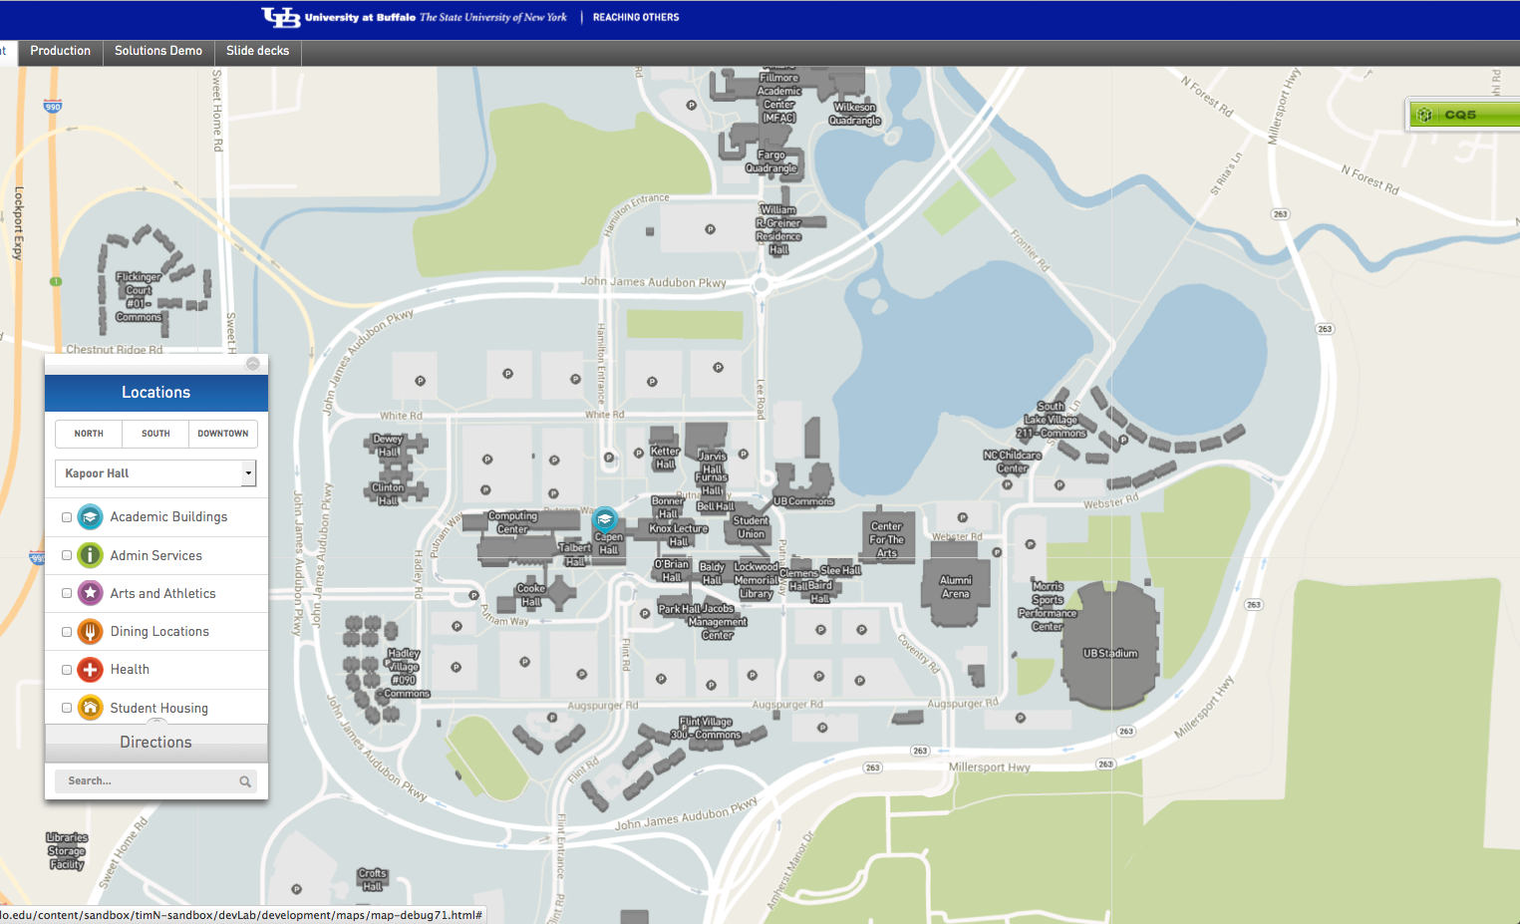

Slide 4
Major Projects in Development
RWD
Finalizing Pilot Rollouts and getting ready for early adopters.
Best Practices
Charge: Create a site where we collect and display the recommended best practices (UI, Page layout, Content). Allow UBCMS authors to “open the hood” and see how it was set up.
Enhancing News Display and Tagging Options
Charge: Diversify the options for creating and displaying collections of unit news. Includes exploring tagging, formats, balancing UB Reporter/News, RSS, customizing articles.
Workflow
Charge: Operationalizing the workflow options available in the UBCMS. Creating recommendations for how to best utilize.
Different Options for User Permissions
Charge: Exploring setting up some of our larger workgroups with the ability to manage their own user. Also looking at finegraining the options for user permissions (e.g. at the folder level of a site, shared content)

